Slide 1

Chapter 25
Domain Name System
25.<number>
Copyright © The McGraw-Hill Companies, Inc. Permission required for reproduction or display.

Slide 2

Figure 25.1 Example of using the DNS service
25.<number>

Slide 3
25-1 NAME SPACE
To be unambiguous, the names assigned to machines must be carefully selected from a name space with complete control over the binding between the names and IP addresses.
Topics discussed in this section:
Flat Name Space
Hierarchical Name Space
25.<number>

Slide 4
25-2 DOMAIN NAME SPACE
To have a hierarchical name space, a domain name space was designed. In this design the names are defined in an inverted-tree structure with the root at the top. The tree can have only 128 levels: level 0 (root) to level 127.
Topics discussed in this section:
Label
Domain Name
Domain
25.<number>

Slide 5

Figure 25.2 Domain name space
25.<number>

Slide 6

Figure 25.3 Domain names and labels
25.<number>

Slide 7
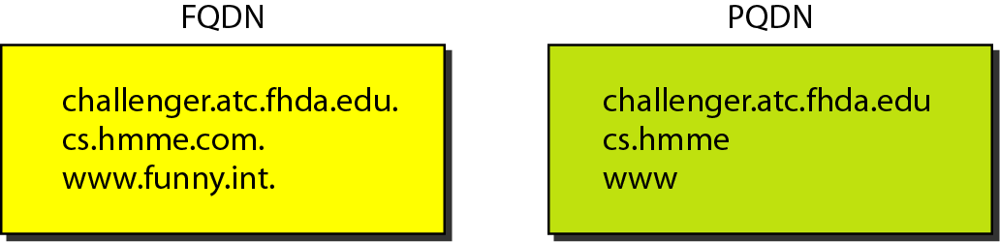
Figure 25.4 FQDN and PQDN
25.<number>

Slide 8

Figure 25.5 Domains
25.<number>

Slide 9
25-3 DISTRIBUTION OF NAME SPACE
The information contained in the domain name space must be stored. However, it is very inefficient and also unreliable to have just one computer store such a huge amount of information. In this section, we discuss the distribution of the domain name space.
Topics discussed in this section:
Hierarchy of Name Servers
Zone
Root Server
Primary and Secondary Servers
25.<number>

Slide 10

Figure 25.6 Hierarchy of name servers
25.<number>

Slide 11

Figure 25.7 Zones and domains
25.<number>

Slide 12
25-4 DNS IN THE INTERNET
DNS is a protocol that can be used in different platforms. In the Internet, the domain name space (tree) is divided into three different sections: generic domains, country domains, and the inverse domain.
Topics discussed in this section:
Generic Domains
Country Domains
Inverse Domain
25.<number>

Slide 13

Figure 25.8 DNS IN THE INTERNET
25.<number>

Slide 14

Figure 25.9 Generic domains
25.<number>

Slide 15

Table 25.1 Generic domain labels
25.<number>

Slide 16

Figure 25.10 Country domains
25.<number>

Slide 17

Figure 25.11 Inverse domain
25.<number>

Slide 18
25-5 RESOLUTION
Mapping a name to an address or an address to a name is called name-address resolution.
Topics discussed in this section:
Resolver
Mapping Names to Addresses
Mapping Addresses to Names
Recursive Resolution
Caching
25.<number>

Slide 19

Figure 25.12 Recursive resolution
25.<number>

Slide 20

Figure 25.13 Iterative resolution
25.<number>

Slide 21

Note
DNS can use the services of UDP or TCP using the well-known port 53.
25.<number>

Slide 22
26-2 ELECTRONIC MAIL
One of the most popular Internet services is electronic mail (e-mail). The designers of the Internet probably never imagined the popularity of this application program. Its architecture consists of several components that we discuss in this chapter.
26.<number>

Slide 23

Figure 26.6 First scenario in electronic mail
26.<number>

Slide 24
Note
When the sender and the receiver of an e-mail are on the same system,
we need only two user agents.
26.<number>

Slide 25

Figure 26.7 Second scenario in electronic mail
26.<number>

Slide 26
Note
When the sender and the receiver of an e-mail are on different systems, we
need two UAs and a pair of
MTAs (client and server).
26.<number>

Slide 27

Figure 26.8 Third scenario in electronic mail
26.<number>

Slide 28
Note
When the sender is connected to the mail server via a LAN or a WAN,
we need two UAs and two pairs
of MTAs (client and server).
26.<number>

Slide 29

Figure 26.9 Fourth scenario in electronic mail
26.<number>

Slide 30

Figure 26.10 Push versus pull in electronic email
26.<number>

Slide 31
Note
When both sender and receiver are connected to the mail server via
a LAN or a WAN, we need two
UAs, two pairs of MTAs
and a pair of MAAs.
This is the most common situation today.
26.<number>

Slide 32

Figure 26.11 Services of user agent
26.<number>

Slide 33
Note
Some examples of command-driven user agents are mail, pine,
and elm.
26.<number>

Slide 34
Note
Some examples of GUI-based user agents are Eudora, Outlook, and Netscape.
26.<number>

Slide 35

Figure 26.12 Format of an e-mail
26.<number>

Slide 36
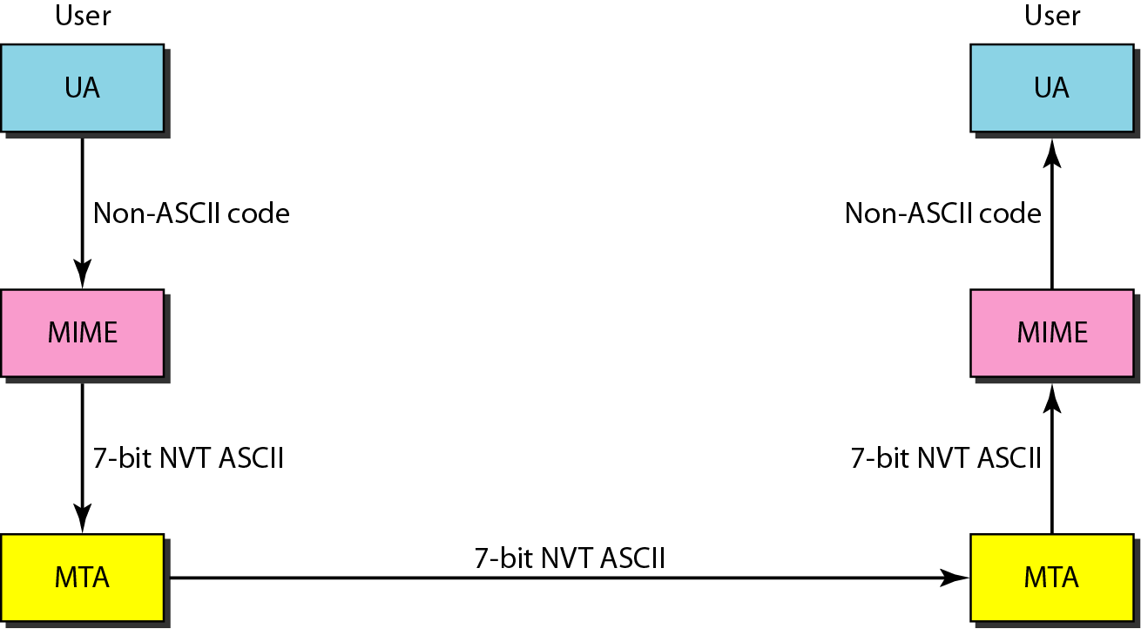
Figure 26.14 MIME
26.<number>

Slide 37
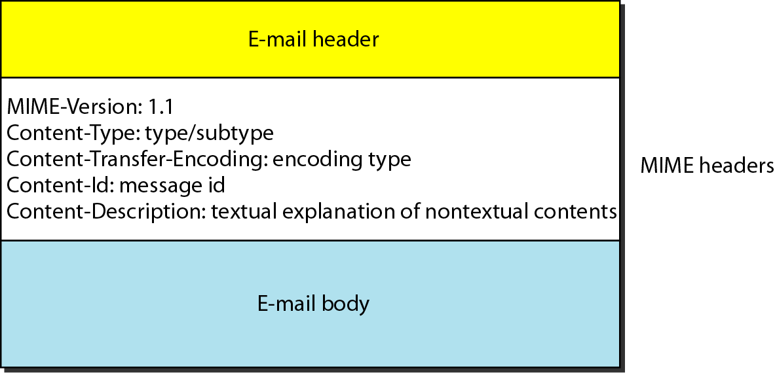
Figure 26.15 MIME header
26.<number>

Slide 38
Table 26.5 Data types and subtypes in MIME
26.<number>

Slide 39
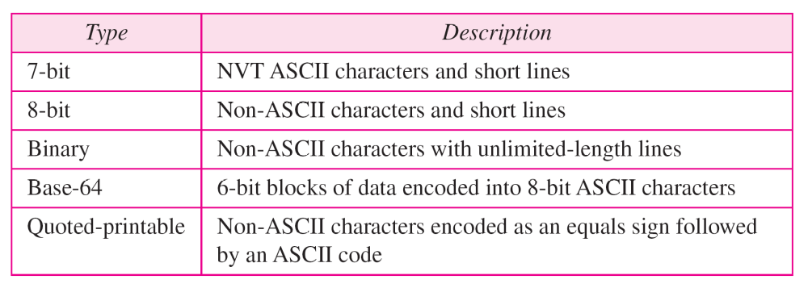
Table 26.6 Content-transfer-encoding
26.<number>

Slide 40
26-3 FILE TRANSFER
Transferring files from one computer to another is one of the most common tasks expected from a networking or internetworking environment. As a matter of fact, the greatest volume of data exchange in the Internet today is due to file transfer.
Topics discussed in this section:
File Transfer Protocol (FTP)
Anonymous FTP
26.<number>

Slide 41
Note
FTP uses the services of TCP. It needs two TCP connections.
The well-known port 21 is used for the control connection and the well-known port 20 for the data connection.
26.<number>

Slide 42
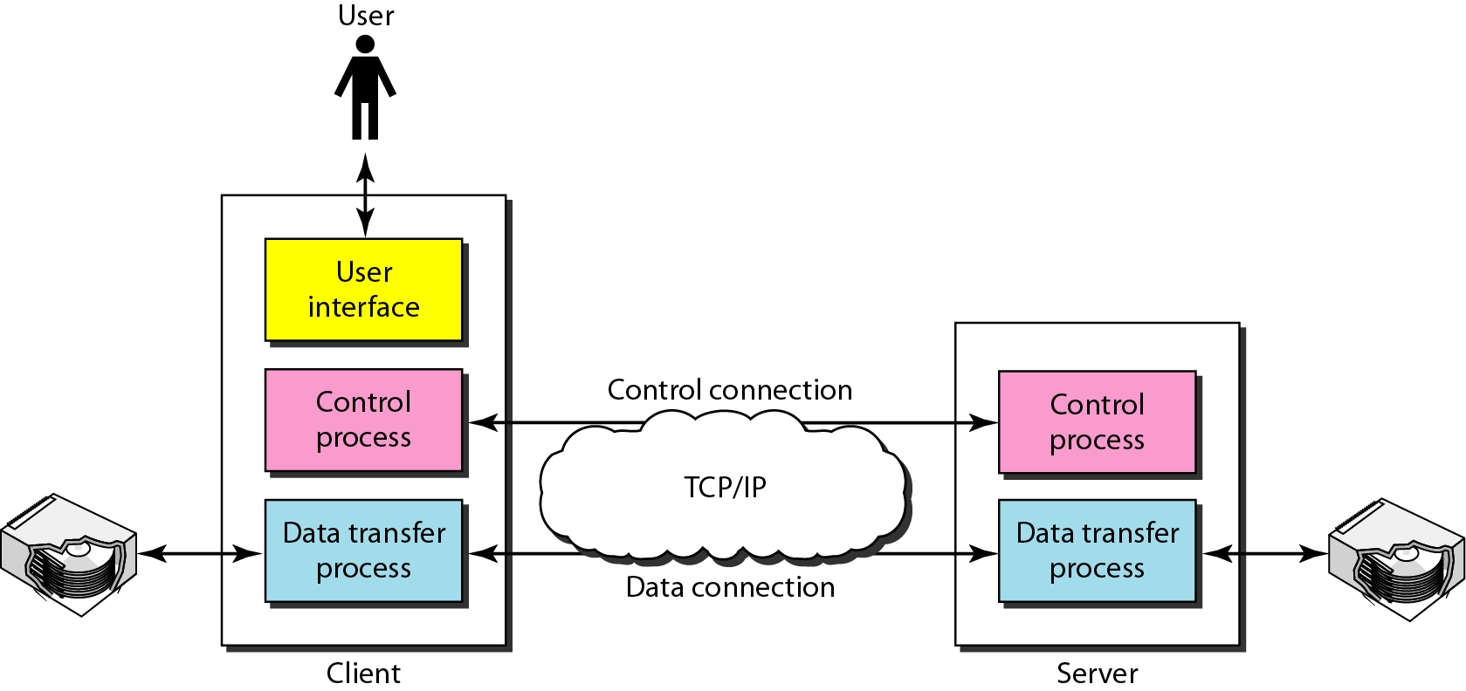
Figure 26.21 FTP
26.<number>

Slide 43
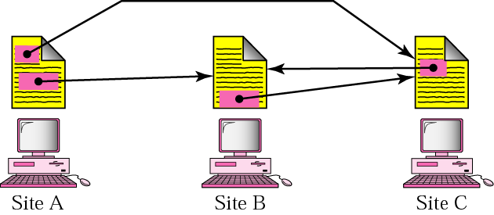
World Wide Web
Distributed services

Slide 44
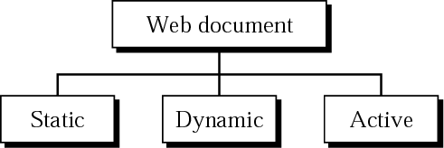
Categories of Web Documents

Slide 45
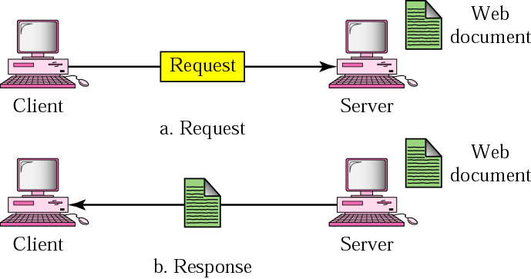
Static Document

Slide 46
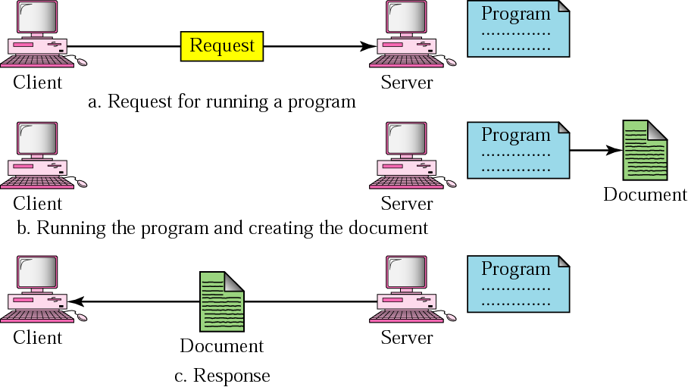
Dynamic Document

Slide 47
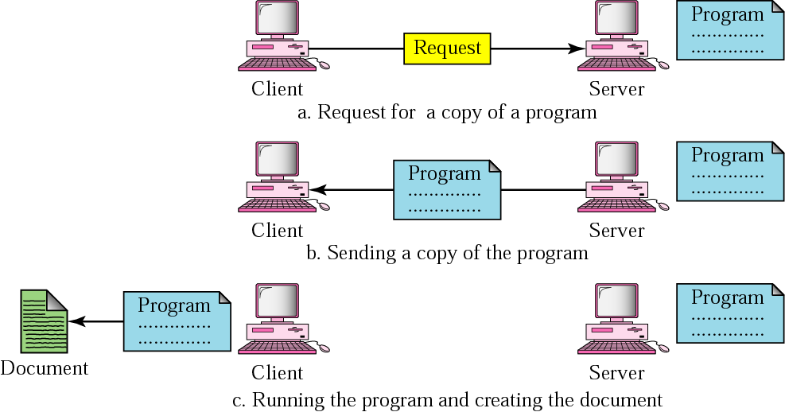
Active Document

